Slide 1
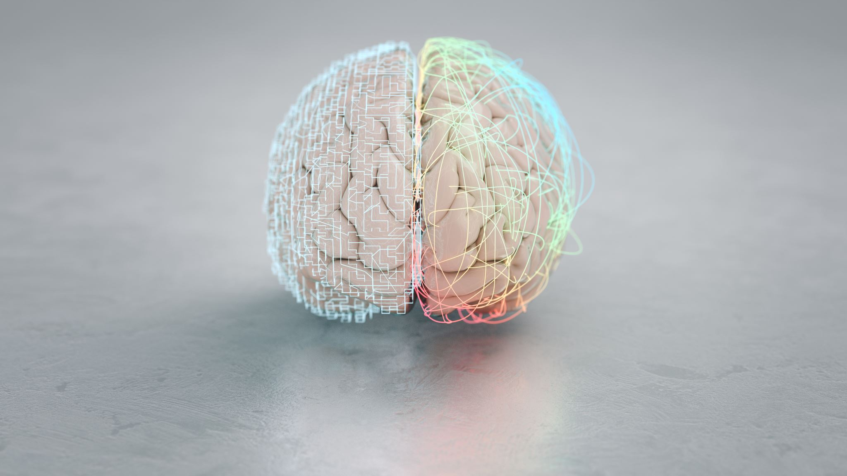

Brain MRI Tumor Classification
with ROI Segmentation
AUTOMATED
DIAGNOSTIC
SYSTEM
MRI · ML · AI-Assisted
ECEN 766 · Algorithms in Structural Bioinformatics
Karthigeyan Muralidharan
Yuvaraj Suresh Babu
Tamil Subbarayakgounder

Slide 2
Motivation & Problem Statement
~300K
5–10%
15–30%
New brain tumor diagnoses annually (US)
Annual mortality improvement with early detection
Diagnostic variability between radiologists
Core Problem:
Manual interpretation of brain MRI scans is time-consuming, subjective, and prone to inter-radiologist variability. Automated, reproducible classification systems are essential for scalable clinical support.
The Challenge
Our Approach
High inter-rater diagnostic inconsistency
Tumor regions are small, irregular, & variable
Non-tumor regions dilute extracted features
Classical full-image feature extraction is noisy
Automated preprocessing & noise reduction
Explicit ROI segmentation before feature extraction
DWT + PCA feature extraction from tumor ROI
SVM classifier with cross-validated evaluation

Slide 3
Research Objectives & Project Scope
Baseline Pipeline
Comparative Evaluation
01
Implement full-image wavelet feature extraction + SVM classification as the performance benchmark.
03
Rigorously compare baseline vs. ROI-based pipelines using accuracy, precision, recall, and F1-score under cross-validation.
ROI Segmentation
Reproducibility
02
Develop a lightweight tumor ROI module using Otsu thresholding + morphological operations to isolate candidate tumor regions.
04
Ensure an interpretable, reproducible MATLAB-based implementation accessible for clinical research and education.

Slide 4
End-to-End System Pipeline
①
②
③
④
⑤
⑥
MRI
Input
Pre-
processing
ROI
Segmentation
Feature
Extraction
Classification
(SVM)
Prediction
Output
Two Pipelines Compared
BASELINE — Full-Image Features
PROPOSED — ROI-Based Features
Input MRI → Preprocessing → DWT + PCA (full image) → SVM
Features extracted from entire image including skull, healthy tissue, and background.
Input MRI → Preprocessing → ROI Segmentation → DWT + PCA (ROI) → SVM
Features extracted exclusively from the isolated tumor region — reducing noise from irrelevant tissue.
vs
Accuracy: ~68–72%
Accuracy: ~72–76%

Slide 5
Architecture Diagram
MRI Scans
Pre-Processing
Canny
PSO
Image Segmentation
Otsu
Watershed
DWT
Feature Extraction
PCA
SVM
Classification
CNN
Lazy IBK
Benign
Malignant

Slide 6
Dataset & Preprocessing Pipeline
Source
Format
Classes
Resolution
Publicly available
brain MRI datasets
2D axial slices
(grayscale 256×256 px)
Binary: Benign
vs. Malignant
Standardized to
256×256 px
Preprocessing Steps
01
Image Resizing
03
Noise Reduction (Median Filter)
Standardize all MRI scans to 256×256 px for consistent feature vector dimensionality across the entire dataset.
Weighted median filtering outperforms adaptive & spatial filters — preserves critical tumor boundary edges while removing salt-and-pepper noise.
02
Grayscale Conversion
04
Intensity Normalization
Convert to grayscale where necessary; MRI scans are inherently single-channel intensity images.
Gaussian smoothing + intensity normalization to reduce inter-sample variability across different MRI acquisition conditions.

Slide 7
ROI Segmentation Module
Why Segment Before Feature Extraction?
Global features extracted from the full MRI image are dominated by skull structures, CSF, and healthy brain tissue — diluting the tumor-specific signal. ROI segmentation isolates the candidate tumor region, improving signal-to-noise ratio for downstream classification.
Step 1
Otsu Thresholding
Step 2
Morphological Operations
Convert preprocessed grayscale image to a binary foreground mask. Otsu's method auto-selects the optimal threshold by minimizing intra-class variance — no manual tuning required.
Apply erosion + dilation (opening/closing) to remove small isolated noise regions and fill holes within the candidate tumor mask, ensuring a clean connected region.
▼
▼
Step 3
Connected Component Analysis
Step 4
ROI Extraction & Masking
Label connected components. Select the most likely tumor candidate based on heuristics: component size (largest bright region), eccentricity, and spatial location.
Crop and mask the original MRI image to the bounding box of the selected component. All downstream feature extraction performed only within this isolated region.
▼
▼

Slide 8
Segmentation Algorithm 1 — Canny Edge Detection
Algorithm 1 / 4
Core Concept
Strengths
Edge detection is the most frequently used approach for segmenting images based on abrupt change in intensity.
The Canny edge detector works in a multi-stage process:
Gaussian Smoothing — suppresses noise before edge detection
Gradient Computation — finds intensity gradients in all directions
Non-Maximum Suppression — thins edges to single-pixel width
Double Thresholding — classifies edges as strong, weak, or non-edges
Edge Tracking by Hysteresis — suppresses weak edges not connected to strong ones
Key Strength: Capable of yielding a totally unbroken edge for the posterior boundary of the brain.
Excellent at detecting thin, continuous boundaries
Multi-stage process makes it robust to noise
Computationally efficient for real-time use
Produces unbroken posterior brain boundary
Limitations
Sensitive to threshold parameter selection
May over-detect edges in noisy images
Detects edges only — does not fill tumor region
CANNY + CNN accuracy: 83% (2nd overall)
Integration Testing: CANNY + (DWT+PCA) + SVM = 71% | CANNY + CNN = 83% | CANNY + (DWT+PCA) + Lazy IBK = 45%

Slide 9
Segmentation Algorithm 2 — Otsu Thresholding
Algorithm 2 / 4
Core Concept
Strengths
Otsu's thresholding is a non-linear operation that converts a grayscale image into a binary image — pixels below or above the threshold are assigned to two distinct levels.
Assumptions:
Image contains two pixel classes following a bi-modal histogram
Foreground pixels (tumor region)
Background pixels (healthy tissue, skull, CSF)
Optimization Goal: Compute the optimal threshold T* that minimizes intra-class variance (σ²_w) while maximizing inter-class variance (σ²_b).
T* = argmin [σ²_w(T)] where σ²_w = ω₁σ₁² + ω₂σ₂²
Fully automatic — no manual threshold tuning
Efficient: O(G) complexity (G = grey levels)
Core method used in our ROI segmentation module
Robust for images with clear bimodal histograms
Limitations
Assumes bi-modal histogram — fails on non-uniform images
Sensitive to intensity variations across MRI scanners
Does not consider spatial context of pixels
OTSU + CNN accuracy: 87% (strong performer)
Integration Testing: OTSU + (DWT+PCA) + SVM = 56% | OTSU + CNN = 87% | OTSU + (DWT+PCA) + Lazy IBK = 45%

Slide 10
Segmentation Algorithm 3 — Watershed
Algorithm 3 / 4
Core Concept
Strengths
Watershed is a gradient-based segmentation technique. It views any grayscale image as a topographic surface:
High intensity → peaks and hills (bright regions)
Low intensity → valleys (dark regions)
Water is simulated flooding from local minima. Watershed boundaries form at ridgelines where flooding from different sources would meet.
Best suited for MRI images with higher intensity contrast between tumor and surrounding tissue.
⚠ Known Issue: May produce over-segmented results due to noise or irregularities in the gradient image.
No prior training data required
Effective at separating touching or overlapping regions
Handles complex irregular tumor shapes well
Good for high-contrast, high-intensity MRI images
Limitations
Prone to over-segmentation from noise/artifacts
Requires pre-processing gradient smoothing
Computationally heavier than thresholding methods
Watershed + CNN accuracy: 76% (lowest CNN combo)
Integration Testing: Watershed + (DWT+PCA) + SVM = 63% | Watershed + CNN = 76% | Watershed + (DWT+PCA) + Lazy IBK = 44%

Slide 11
Segmentation Algorithm 4 — Particle Swarm Optimization (PSO)
★ Algorithm 4 / 4 — BEST
PSO gives the best segmentation results among all 4 algorithms implemented — and PSO + CNN achieves the highest overall accuracy at 91%.
Core Concept
Why PSO Wins
PSO is based on swarm intelligence — inspired by the collective behavior of bird flocking and fish schooling.
Each candidate threshold is a 'particle' in the solution space:
Each particle has a fitness value (evaluated by a fitness function) and a velocity vector
Particles explore the solution space guided by their personal best and the global swarm best
Position update: x(t+1) = x(t) + v(t+1)
Velocity update: v(t+1) = ωv(t) + c₁r₁(pbest - x) + c₂r₂(gbest - x)
Starts with a group of randomly generated solutions and iteratively converges on the optimal segmentation threshold.
Global search avoids local optima unlike greedy threshold methods
No assumptions about intensity distribution (unlike Otsu)
Adapts to complex, multi-region tumor boundaries
Produces cleanest tumor mask → best downstream features
Performance Summary
PSO + CNN
91% ★ BEST
PSO + (DWT+PCA) + SVM
45%
PSO + (DWT+PCA) + Lazy IBK
45%
★ PSO achieves the best segmentation quality of all 4 algorithms — PSO + CNN at 91% is the top-performing combination in the entire integration test suite.

Slide 12
Feature Extraction: DWT + PCA
Discrete Wavelet Transform (DWT)
Principal Component Analysis (PCA)
Decomposes MRI image into multi-resolution frequency subbands: LL (approximation), LH, HL, HH (detail).
Wavelet coefficients localize frequency information of the signal — critical for capturing texture and edge patterns at different spatial scales.
Statistical features (mean, variance, energy, entropy) are extracted from each subband to form a compact representation of the tumor region.
DWT produces a high-dimensional coefficient matrix. PCA is applied to reduce this large dimensionality before classification.
Computes Eigenvectors of the covariance matrix and approximates the data by a linear combination of the leading eigenvectors.
Retains maximum variance in the data with minimal components — reducing redundancy and improving SVM classifier performance.
DWT + PCA Pipeline Flow
Segmented
MRI (ROI)
DWT
Decomposition
Subband
Coefficients
PCA
Dimensionality
Reduction
Compact
Feature
Vector
SVM
Classifier

Slide 13
Feature Extraction — Extracted GLCM Feature Values
Sample extracted feature values from a segmented tumor ROI — these 13 GLCM + statistical features form the input vector to the SVM classifier.
Contrast
Correlation
Energy
Homogeneity
Mean
0.25713
0.20935
0.84158
0.9548
0.0022578
Measures local intensity variation. Tumor regions show higher contrast than healthy tissue.
Statistical correlation of adjacent pixel pairs. Reflects directional texture patterns in tumor.
Sum of squared GLCM elements. High energy indicates uniform, ordered texture in tumor region.
Closeness of distribution to diagonal. High value means similar adjacent pixel pairs dominate.
Average pixel intensity of the segmented tumor ROI after normalization and masking.
Std. Deviation
Entropy
RMS
Variance
Smoothness
0.081086
2.598
0.081111
0.006529
0.92699
Spread of intensity distribution. Higher std deviation indicates heterogeneous tumor texture.
Measures randomness/complexity of the image texture. Malignant tumors typically show higher entropy.
Root Mean Square intensity. Closely tracks standard deviation for zero-mean normalized images.
Second-order moment of pixel distribution. Captures overall intensity variability in ROI.
Relative smoothness derived from variance. High smoothness = low contrast uniform regions.
Kurtosis = 21.659
Skewness = 1.8939
IDM (Homogeneity) = -0.88655
Sharpness of pixel distribution peak. High kurtosis in tumor regions reflects concentrated bright spots.
Asymmetry of distribution. Positive skew indicates more pixels below mean — characteristic of tumors.
Inverse Difference Moment. Measures local homogeneity with more weight for near-diagonal entries.

Slide 14
Classification Methods
Primary Classifier
Non-probabilistic binary linear classifier; constructs optimal hyperplane maximizing margin between benign/malignant feature distributions
Accepts DWT+PCA feature vectors as input; generates a training model after scaling, selecting, and validating features
Accuracy directly tied to the quality of features from segmentation + extraction — relies on clean ROI masks
Both linear and RBF kernels evaluated; computationally efficient on standard hardware without GPU
Support Vector Machine (SVM)
Baseline Comparator
Instance-based k-nearest neighbor semi-supervised learning algorithm
Stores all training examples and defers model building until classification time ('lazy learning')
Classifies by majority vote among k nearest neighbors using distance computation in feature space
Requires training data + predefined k value; no explicit model built — highly interpretable but dimensionality-sensitive
Lazy IBK (k-NN)
Best Accuracy
Input is multi-channeled segmented image — does NOT use hand-crafted DWT+PCA features
Learns spatial hierarchies automatically: edges → textures → patterns → tumor classification
Training time: minutes to hours depending on dataset volume and model depth
Achieves the best result of the 3 classifiers — PSO + CNN delivers 91% peak accuracy
Convolutional Neural Network (CNN)

Slide 15
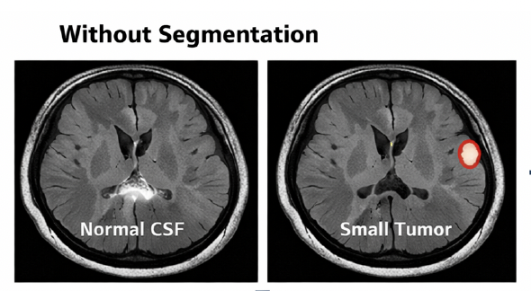
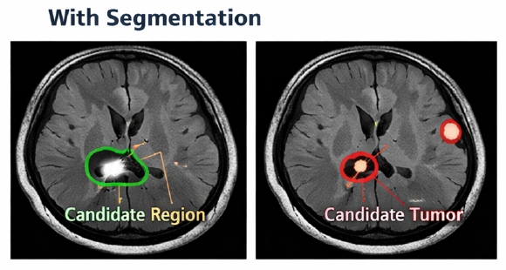
Graphical User Interface (GUI) — MATLAB
Brain_Tumor
— □ ×
Brain MRI
Segmentation
[ MRI Image
Display Area ]
[ Segmented
Tumor Output ]
OTSU
① Input MRI Display
CANNY
PSO
Watershed
Load MRI
Benign
② Load MRI Scan
Feature Extraction
Classification
③ DWT+PCA Feature Extraction
DWT + PCA
SVM
Lazy IBK
CNN
④ Segmentation Algorithm (OTSU/CANNY/PSO/Watershed)
⑤ Benign/Malignant Output
⑥ Classification (SVM/IBK/CNN)

Slide 16
Experimental Design & Evaluation Protocol
Dataset Splitting
Control Variables
Stratified splitting ensures balanced class distribution
5-fold cross-validation when dataset size permits
Repeated hold-out for smaller datasets
Patient-level splits to prevent data leakage
Identical dataset, training protocol, and SVM config
Only variable changed: full-image vs. ROI features
Same DWT+PCA code applied to both pipelines
Isolates the exact impact of ROI segmentation
Performance Metrics
Accuracy
Precision
Recall
(Sensitivity)
F1-Score
(TP + TN) / Total
TP / (TP + FP)
TP / (TP + FN)
2×(P×R)/(P+R)
Overall correct classifications
True positives among predicted positives
Critical for clinical safety
Harmonic mean of precision & recall

Slide 17
Results & Performance Comparison
68–72%
72–76%
+4–5%
91%
Baseline
Accuracy
ROI Pipeline
Accuracy
Improvement
from ROI
Best result
(PSO + CNN)

Slide 18
Analysis & Discussion
ROI Segmentation Provides Moderate but Meaningful Gains
The ROI-based pipeline consistently outperforms the baseline by ~4–5%. In medical imaging, even small precision gains reduce false negatives that endanger patient safety.
Segmentation Quality is the Critical Bottleneck
Classification performance is tightly coupled to segmentation robustness. Investing in better segmentation (e.g., PSO → CNN: 91%) yields greater downstream gains than classifier tuning.
CNN Dominates Classical Methods — PSO + CNN Achieves 91%
CNN outperforms SVM and Lazy IBK across all segmentation methods. PSO + CNN is the top combination — CNN learns discriminative spatial features without hand-crafted DWT+PCA engineering.
Lazy IBK Consistently Underperforms (~44–45%)
k-NN performs near-chance level in high-dimensional DWT+PCA feature space — victim of the curse of dimensionality. Applying PCA dimensionality reduction could potentially improve IBK performance.
Overall Takeaway: ROI segmentation is a valuable preprocessing step, but maximum gains require improved segmentation robustness and the expressive power of deep learning classifiers.

Slide 19
Challenges, Limitations & Mitigations
Challenge | Limitation | Proposed Mitigation
Threshold Sensitivity in ROI Segmentation | Otsu thresholding performance degrades when intensity distributions shift across MRI acquisition conditions — inconsistent tumor boundaries. | Explore adaptive thresholding and multi-level Otsu; add morphological cleanup with tuned kernel sizes.
High-Dimensional Feature Space | Combining DWT and PCA features can still yield redundant dimensions; inflated feature vectors reduce SVM margin quality. | Evaluate feature importance via SVM weights; apply aggressive PCA variance retention thresholds to prune uninformative components.
Dataset Variability & Quality | MRI scans exhibit intensity inconsistencies, motion artifacts, and scanner-dependent contrast — leading to unstable generalization. | Stringent preprocessing validation; visualize samples pre/post pipeline; consider histogram equalization for contrast harmonization.
Small & Imbalanced Datasets | Limited labeled brain MRI datasets cause overfitting and biased metrics, especially for the minority class. | Stratified k-fold cross-validation; report class-specific precision/recall; data augmentation (rotation, flipping, brightness).

Slide 20
Future Scope & Extensions
Near-term
Near-term
Long-term
🧠 Deep Segmentation (U-Net)
📊 Multi-Class Grading
☁️ Cloud Integration
Replace threshold-based ROI with a trained U-Net for pixel-level tumor masks ; dramatically reducing segmentation errors on low-contrast tumors.
Extend binary classifier to 4-class grading: Glioma, Meningioma, Pituitary, Normal ; requires multi-class SVM or softmax CNN head.
Deploy as a cloud-hosted API. Partner MRI centers upload scans; system returns classification in real time ; enabling continuous model retraining.
Long-term
Aspirational
Aspirational
🔬 3D Volumetric Analysis
⚡ Real-Time MRI Integration
📈 Explainability (XAI)
Extend from 2D slice-based to 3D volumetric CNN (e.g., ResNet-3D). Captures inter-slice spatial relationships missed by 2D models.
Interface directly with MRI scanner output for real-time classification during scanning sessions. Requires sub-second inference and DICOM compatibility.
Grad-CAM and SHAP to generate visual explanations of CNN decisions ; critical for clinical trust and regulatory compliance in medical AI.

Slide 21
Conclusions
1
PSO achieves the best segmentation of all 4 algorithms , PSO + CNN delivers the peak accuracy of 91% in the entire benchmark
Thank You
2
ROI segmentation consistently improves accuracy by ~4–5% over the full-image baseline by reducing feature noise from non-tumor tissue
3
DWT + PCA feature extraction provides compact, discriminative representations , quality directly determines classifier ceiling
ECEN 766
Structural Bioinformatics
Texas A&M University
4
Segmentation quality is the single most critical bottleneck , better tumor masks translate directly to better classification
5
The proposed pipeline is interpretable, reproducible, and runnable on standard hardware without GPU requirements

